Slide 1
Software Testing
Chapter 2 Black-Box Testing

Slide 2

Contents
Black-Box Testing
2.1 Introduction
2.2 Equivalence Partitioning
Examples
2.3 Boundary Value Analysis
2.4 Decision Tables
2.5 Cause-Effect Graphing
2.6 Orthogonal Array Testing
2.7 Scenario Testing
Chapter 2

Slide 3
Review-2.2 Equivalence Partitioning
F(x₁,x₂)
  Two sub-domains [e,f) and [f,g] for x₁
  Three sub-domains [a,b), [b,c) and [c,d] for x₂
x₁
g
f
Cartesian product
e
0
x₂
a
b
c
d
Notes:
单缺陷假设：可靠性理论中的一个关键假设，假设失效极少是由2个或多个缺陷同时发生引起的

Slide 4
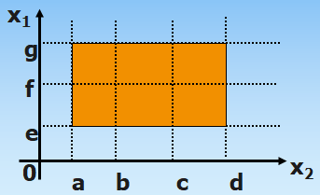
Review-2.2 Constraints
Weak
(single defect)
Traditional
/Normal
(valid)
Strong
(mult. defect)
Robust
(valid&invalid)
Strong robust
Weak traditional
Strong traditional
Weak robust
Notes:
弱：只单缺陷假设。
强：多缺陷假设。
一般：考虑有效值。
健壮：考虑无效值。

Slide 5
Review-2.2 Test case design-I
F(x₁,x₂)
  Two sub-domains [e,f) and [f,g] for x₁
  Three sub-domains [a,b), [b,c) and [c,d] for x₂
x₁
Input variables | Valid Equivalence Class(EC) | Invalid EC
Input-1 | （1）EC1 | （4）EC3
 | （2）EC2
Input-2 | （3）…… | （5）……
g
f
e
0
x₂
a
b
c
d
Notes:
单缺陷假设：可靠性理论中的一个关键假设，假设失效极少是由2个或多个缺陷同时发生引起的

Slide 6
Review-2.2 Test case design-II
Weak Robust
  Design test cases so that all valid equivalence classes can be included (using as few cases as possible)
  Design a test case for each invalid equivalence class (one input variable is invalid while others are valid)
Strong Robust?
Test Case ID | month | day | year | Expected Output
WR1 | 6 | 15 | 1912 | 1912.6.16
WR2 | -1 | 15 | 1912 | Invalid Month
WR3 | 13 | 15 | 1912 | Invalid Month
WR4 | 6 | -1 | 1912 | Invalid Day
WR5 | 6 | 32 | 1912 | Invalid Day
WR6 | 6 | 15 | 1811 | Invalid Year
WR7 | 6 | 15 | 2014 | Invalid Year
Notes:
单缺陷假设：可靠性理论中的一个关键假设，假设失效极少是由2个或多个缺陷同时发生引起的

Slide 7
Review-2.3 Boundary Value Analysis
Background
  Errors tend to occur near the extreme values of an input variable
  Find the boundary values based on equivalence classes
  Five points: use input variable values at their minimum (min), just above the minimum (min+), a nominal value (nom), just below their maximum (max-), and at their maximum (max)
min
min+
nom
max-
max
Notes:
单缺陷假设：可靠性理论中的一个关键假设，假设失效极少是由2个或多个缺陷同时发生引起的

Slide 8
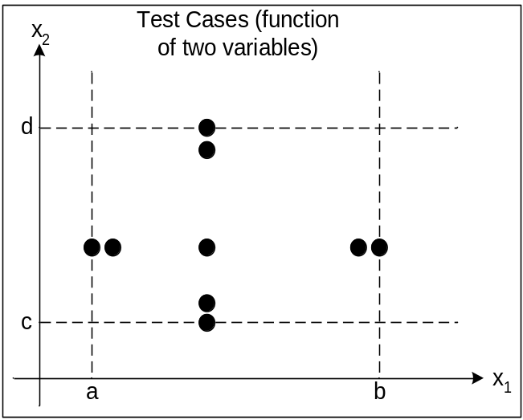
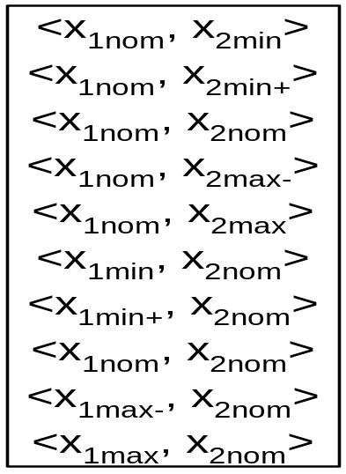
Review-2.3 Test Case Design
A single input variable
  Five values
min
min+
nom
max-
max
Multiple input variables
  1) The selected one changes from min, min+, nom, max- to max, while others are fixed as nom.
  2) Repeat 1) for each input variable (#cases=4n+1)
Notes:
单缺陷假设：可靠性理论中的一个关键假设，假设失效极少是由2个或多个缺陷同时发生引起的

Slide 9
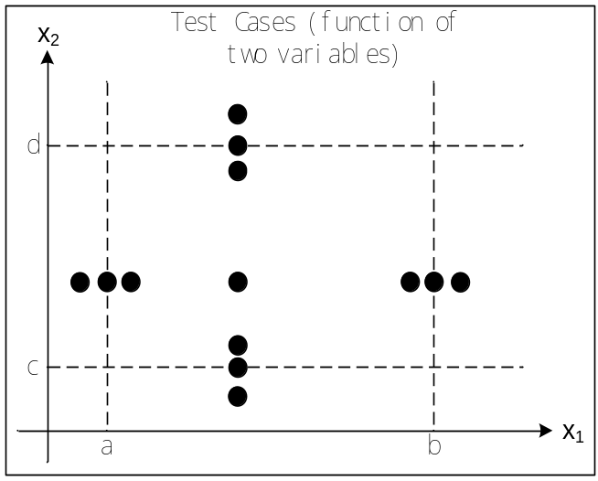
Review-2.3 Robust Boundary Value Analysis
Basic idea:
  Seven points: additionally add two points: just below the minimum (min-) and just above their maximum (max+) (#cases = 6n+1)
min-
min
min+
nom
max-
max
max+
Notes:
单缺陷假设：可靠性理论中的一个关键假设，假设失效极少是由2个或多个缺陷同时发生引起的

Slide 10
Review-2.3 Worst Boundary Value Analysis
(Robust) boundary value analysis: single defect assumption
Now remove this assumption: what will happen if multiple variables have extreme values?
  Sample values
  Cartesian Product
  #cases = 5^{n}
x2
c
d
a
b
x1
Notes:
单缺陷假设：可靠性理论中的一个关键假设，假设失效极少是由2个或多个缺陷同时发生引起的

Slide 11
Review-2.3 Robust Worst Boundary Value Analysis
  Sample seven values for each input variable based on the “Seven Points” method (#cases = 7^{n})
x2
c
d
a
b
x1
Notes:
单缺陷假设：可靠性理论中的一个关键假设，假设失效极少是由2个或多个缺陷同时发生引起的

Slide 12
Contents
Black-Box Testing
2.1 Introduction
2.2 Equivalence Partitioning
Examples
2.3 Boundary Value Analysis
2.4 Decision Tables
2.5 Cause-Effect Graphing
2.6 Orthogonal Array Testing
2.7 Scenario Testing
Chapter 2

Slide 13
2.4 Decision Tables
Among all the functional testing methods, methods based on decision tables are the most rigorous, because decision tables enforce logical rigor.
They are ideal for describing situations in which a lot of combinations of actions are taken under varying sets of conditions.
Notes:
在所有功能测试方法中，决策表是最严格的，因为决策表具有逻辑严格性。
自60年代初期以来，决策表一直被用来表示和分析复杂逻辑关系。
决策表就是判定表，是分析和表达多逻辑条件下执行不同操作的情况的工具。
决策表能够将各种复杂情况都列举出来，不会产生遗漏，因此，使用决策表设计出的测试用例是完整的测试用例集合。
Rigorous [‘rɪg(ə)rəs] 严格的，严厉的

Slide 14
2.4.1 An Example
Suggestions for reading
  There exist three questions when readers are reading some materials or books. For each question, we mark it with a symbol “Y” if the answer given by the reader is “yes” (i.e., True in the decision table); and “N”, otherwise.
  Based on the answers of the three questions, we recommend readers four possible behaviors (i.e., suggestions with “√” in the decision table)
Notes:
在所有功能测试方法中，决策表是最严格的，因为决策表具有逻辑严格性。
自60年代初期以来，决策表一直被用来表示和分析复杂逻辑关系。
决策表就是判定表，是分析和表达多逻辑条件下执行不同操作的情况的工具。
决策表能够将各种复杂情况都列举出来，不会产生遗漏，因此，使用决策表设计出的测试用例是完整的测试用例集合。

Slide 15
“ Reading Guideline ”Decision Table
rule choice |  | 1 | 2 | 3 | 4 | 5 | 6 | 7 | 8
question | tired | Y | Y | Y | Y | N | N | N | N
 | interesting | Y | Y | N | N | Y | Y | N | N
 | confused | Y | N | Y | N | Y | N | Y | N
suggestion | repeat |  |  |  |  | √
 | continue |  |  |  |  |  | √
 | skip |  |  |  |  |  |  | √ | √
 | rest | √ | √ | √ | √
Notes:
有限条目，扩展条目（条件有多个值对应）

Slide 16
2.4.2 Elements in Decision Tables
Four elements of decision table:
  Condition Stub: conditions/questions of the given problem
  Condition Entry: possible values (choices) for each condition
  Action Stub: possible actions for the given problem
  Action Entry: which action is taken
Notes:
左侧是桩部分，右侧是条目部分，上面是条件部分，下面是行动部分。因此，可以引用条件桩，行动桩，条件条目和行动条目。
条目部分的一列是一条规则。规则指示在规则的条件部分中指示的条件环境下要采取什么行动。
条件桩 条件项
动作桩 动作项

Slide 17
2.4.2 Elements in Decision Tables
Four elements of decision table:
  Condition Stub (1)
  Condition Entry (2)
  Action Stub (3)
  Action Entry (4)
A rule indicates that which action should be taken for the combination of values of conditions (i.e., one column in the decision table). #rules=how many combinations?
(1)
(2)
(3)
(4)
rule
Notes:
左侧是桩部分，右侧是条目部分，上面是条件部分，下面是行动部分。因此，可以引用条件桩，行动桩，条件条目和行动条目。
条目部分的一列是一条规则。规则指示在规则的条件部分中指示的条件环境下要采取什么行动。
条件桩 条件项
动作桩 动作项

Slide 18
“ Reading Guideline ”Decision Table
rule choice |  | 1 | 2 | 3 | 4 | 5 | 6 | 7 | 8
question | tired | Y | Y | Y | Y | N | N | N | N
 | interesting | Y | Y | N | N | Y | Y | N | N
 | confused | Y | N | Y | N | Y | N | Y | N
suggestion | repeat |  |  |  |  | √
 | continue |  |  |  |  |  | √
 | skip |  |  |  |  |  |  | √ | √
 | rest | √ | √ | √ | √
Notes:
有限条目，扩展条目（条件有多个值对应）

Slide 19
2.4.3 Favorite Scenario for Decision Table
Advantages：
  Given a complex problem, it can enumerate all possible combinations of input variables, and then help testers to design complete test cases.
Favorite Scenario: some actions are taken based on the combination of multiple conditions

Slide 20
2.4.4 Design Decision Table-I
Five steps：
  How many rules? n conditions → 2^{n} rules (if only True or False for each condition)
  List all condition stubs and action stubs
  List all rules (condition values and action)
  Simplify the decision table by merging similar rules

Slide 21
2.4.4 Design Decision Table-II
Merging Rules: if two or more rules correspond to the same action and these rules are similar to each other, then they can be merged.
Values of merged conditions are marked with “-”. “-” indicates that the action is independent of the value.
Notes:
“-” short line.

Slide 22
“ Reading Guideline ”Decision Table
rule choice |  | 1 | 2 | 3 | 4 | 5 | 6 | 7 | 8
question | tired | Y | Y | Y | Y | N | N | N | N
 | interesting | Y | Y | N | N | Y | Y | N | N
 | confused | Y | N | Y | N | Y | N | Y | N
suggestion | repeat |  |  |  |  | √
 | continue |  |  |  |  |  | √
 | skip |  |  |  |  |  |  | √ | √
 | rest | √ | √ | √ | √
Notes:
有限条目，扩展条目（条件有多个值对应）

Slide 23
A simplified decision table “Reading Guideline”
choice rule |  | 1-4 | 5 | 6 | 7-8
question | tired | Y | N | N | N
 | interesting | － | Y | Y | N
 | confused | － | Y | N | -
suggestion | repeat |  | √
 | continue |  |  | √
 | skip |  |  |  | √
 | rest | √

Slide 24
2.4.5 The Triangle Example
It receive there integers a, b, c as input. A triangle is formed if a, b, c satisfy these conditions below:
  C1. a < b + c
  C2. b < a + c
  C3. c < a + b
Four possible outputs: Not a Triangle, Scalene, Isosceles, and Equilateral.
Notes:
Scalene [‘skeɪliːn] 不等边三角形
Isosceles [aɪ‘sɒsɪliːz] 等腰三角形
Equilateral [,iːkwɪ‘læt(ə)r(ə)l; ,ekwɪ-] 等边三角形

Slide 25
cannot be merged
Decision table of triangle problem
c1: a、b、c form a triangle？ | N | Y | Y | Y | Y | Y | Y | Y | Y
c2: a=b? | － | Y | Y | Y | Y | N | N | N | N
c3: a=c? | － | Y | Y | N | N | Y | Y | N | N
c4: c=b? | － | Y | N | Y | N | Y | N | Y | N
a1: not a triangle | ×
a2: scalene |  |  |  |  |  |  |  |  | ×
a3: isosceles |  |  |  |  | × |  | × | ×
a4: equilateral |  | ×
a5:impossible |  |  | × | × |  | ×
Notes:
以三角形为例，说明一下
为了使用决策表标识测试用例，我们把输入作为条件，把输出作为行动。或者条件是输入的等价类，行动是被测软件的主要功能处理部分。
这时的规则解释为测试用例，由于决策表是强制完备的，因此可以得到测试用例的完整集合
这里有不可能和不适用的例子，为啥，行动相同合并
Scalene [‘skeɪliːn] 不等边三角形
Isosceles [aɪ‘sɒsɪliːz] 等腰三角形
Equilateral [,iːkwɪ‘læt(ə)r(ə)l; ,ekwɪ-] 等边三角形
不可合并

Slide 26
Test Case for the Triangle Problem
Test Case ID | a | b | c | Expected output
DT1 | 4 | 1 | 2 | Not a triangle
DT2 | 1 | 4 | 2 | Not a triangle
DT3 | 1 | 2 | 4 | Not a triangle
DT4 | 5 | 5 | 5 | equilateral
DT5 | ? | ? | ? | impossible
DT6 | ? | ? | ? | impossible
DT7 | 2 | 2 | 3 | isosceles
DT8 | ? | ? | ? | impossible
DT9 | 2 | 3 | 3 | isosceles
DT10 | 3 | 2 | 2 | isosceles
DT11 | 3 | 4 | 5 | scalene
Notes:
每个rule至少一个case

Slide 27
The selection of conditions will heavily decide the number of rules
  E.g.：“a,b,c form a triangle?” or three conditions
    a+b>c?
    b+c>a?
    c+a>b?

Slide 28
Refined Decision Table for the Triangle Problem
c1: a <b + c? | F | T | T | T | T | T | T | T | T | T | T
c2: b <a + c? | － | F | T | T | T | T | T | T | T | T | T
c3: c <b + a? | － | － | F | T | T | T | T | T | T | T | T
c4: a = b? | － | － | － | T | T | T | T | F | F | F | F
c5: a = c? | － | － | － | T | T | F | F | T | T | F | F
c6: b = c? | － | － | － | T | F | T | F | T | F | T | F
Rules count | 32 | 16 | 8 | 1 | 1 | 1 | 1 | 1 | 1 | 1 | 1
a1: not a triangle | × | × | ×
a2: scalene |  |  |  |  |  |  |  |  |  |  | ×
a3: isosceles |  |  |  |  |  |  | × |  | × | ×
a4: equilateral |  |  |  | ×
a5:impossible |  |  |  |  | × | × |  | ×
Notes:
决策表可以给出另外一种考虑：将老条件（c1:a、b、c构成三角形？）扩展为三角形特性的三个不等式的详细表示。或者再加条件a=b+c 严格大于
4个条件变成6个
条件的选择可以扩大决策表的规模
不关心条目的使用，对决策表的识别方式有微妙的影响，对于有限条目的决策表，n个条件，2n个规则，如果不关心条目明确地表明是不相关的，则1 如果没有不关心条目的规则加1，2 每出现1个不关心条目，规则乘以2

Slide 29
2.4.5 The NextDate Example
NextDate Function（First Try）
Equivalence classes：
M1 = {month:month has 30 days}
M2 = {month:month has 31 days}
M3 = {month:month is February}
D1 = {day:1≤day≤28}
D2 = {day:day=29}
D3 = {day:day=30}
D4 = {day:day=31}
Y1 = {year:year is a leap year}
Y2 = {year:year is a common year}
C1: month in M1？ | T
C2: month in M2？ |  | T
C3: month in M3？ |  |  | T
C4: day in D1？
C5: day in D2？
C6: day in D3？
C7: day in D4？
C8: year in Y1？
a1: impossible
a2: next date
Notes:
带有互斥条件的决策表规则统计，应该有8条规则，实际显示是12,相互关联，决策表强调依赖关系

Slide 30
Conditions | Rule1 | Rule2 | Rule3
C1: month in M1？ | T | － | －
C2: month in M2？ | － | T | －
C3: month in M3？ | － | － | T
Rules count | 4 | 4 | 4
a1
2³=8 (FFF)
Conditions | 1.1 | 1.2 | 1.3 | 1.4 | 2.1 | 2.2 | 2.3 | 2.4 | 3.1 | 3.2 | 3.3 | 3.4
C1: month in M1？ | T | T | T | T | T | T | F | F | T | T | F | F
C2: month in M2？ | T | T | F | F | T | T | T | T | T | F | T | F
C3: month in M3？ | T | F | T | F | T | F | T | F | T | T | T | T
Rules count | 1 | 1 | 1 | 1 | 1 | 1 | 1 | 1 | 1 | 1 | 1 | 1
a1
Notes:
条件3个，2的3次方是8，显示是12，为啥？因为有重复出现的
合并相同的，颜色，缺少？FFF

Slide 31
Conditions | 1.1 | 1.2 | 1.3 | 1.4 | 2.3 | 2.4 | 3.4
C1: month in M1？ | T | T | T | T | F | F | F | F
C2: month in M2？ | T | T | F | F | T | T | F | F
C3: month in M3？ | T | F | T | F | T | F | T | F
Rules count | 1 | 1 | 1 | 1 | 1 | 1 | 1 | 1
a1: Impossible | × | × | × |  | × |  |  | ×
Notes:
这种识别完备决策表的能力，使我们在解决冗余性和不一致性方面处于有利地位
包含不可能出现的规则的相互排斥条件的规则

Slide 32
  A redundant decision table
Conditions | 1-4 | 5 | 6 | 7 | 8 | 9
C1 | T | F | F | F | F | T
C2 | － | T | T | F | F | F
C3 | － | T | F | T | F | F
a1 | × | × | × | － | － | ×
a2 | － | × | × | × | － | －
a3 | × | － | × | × | × | ×
Notes:
冗余的，为啥？
作为测试用例，有问题？没有，规则9与规则1-4的行为相同，不矛盾

Slide 33
  A inconsistent decision table
Conditions | 1-4 | 5 | 6 | 7 | 8 | 9
C1 | T | F | F | F | F | T
C2 | － | T | T | F | F | F
C3 | － | T | F | T | F | F
a1 | × | × | × | － | － | －
a2 | － | × | × | × | － | ×
a3 | × | － | × | × | × | －
ERROR!
Attention:
  Rule4 and Rule9 is inconsistent.
  Decision table is uncertain.
  Be careful to use the independent entry.
Notes:
测试人员的基本准则是在决策表中小心使用不关心条目

Slide 34
NextDate Function（Second Try）
  Equivalence classes
    M1 = {month： month has 30 days}
    M2 = {month： month has 31 days}
    M3 = {month：month is February}
    D1 = {day：1≤day≤28}
    D2 = {day：day=29}
    D3 = {day：day=30}
    D4 = {day：day=31}
    Y1 = {year：year is 2000}
    Y2 = {year：year is a leap year}
    Y3 = {year：year is a common year}
Notes:
采用扩展条目决策表的开发，仔细研究行动桩。
在扩展条目决策表时，保证等价类构成输入定义域的真划分，即不相交子集的全体，如果条目之间存在重叠，则会有冗余现象，使得多个规则满足
这里 1812-2012，2000年除外

Slide 35
    M1 = {month： month has 30 days}
    M2 = {month： month has 31 days}
    M3 = {month：month is February}
    D1 = {day：1≤day≤28}
    D2 = {day：day=29}
    D3 = {day：day=30}
    D4 = {day：day=31}
    Y1 = {year：year is 2000}
    Y2 = {year：year is a leap year}
    Y3 = {year：year is a common year}
NextDate Function（Second Try Test Cases）
Conditions | 1 | 2 | 3 | 4 | 5 | 6 | 7 | 8 | 9 | 10 | 11 | 12 | 13 | 14 | 15 | 16
C1：month in | M1 | M1 | M1 | M1 | M2 | M2 | M2 | M2 | M3 | M3 | M3 | M3 | M3 | M3 | M3 | M3
C2：day in | D1 | D2 | D3 | D4 | D1 | D2 | D3 | D4 | D1 | D1 | D1 | D2 | D2 | D2 | D3 | D4
C3：year in | － | － | － | － | － | － | － | － | Y1 | Y2 | Y3 | Y1 | Y2 | Y3 | － | －
Rule count | 3 | 3 | 3 | 3 | 3 | 3 | 3 | 3 | 1 | 1 | 1 | 1 | 1 | 1 | 3 | 3
a1：impossible |  |  |  | × |  |  |  |  |  |  |  |  |  | × | × | ×
a2：increment day | × | × |  |  | × | × | × |  | × | × | ×
a3：reset day |  |  | × |  |  |  |  | × |  |  | × | × | ×
a4：increment month |  |  | × |  |  |  |  | ? |  |  | × | × | ×
a5：reset month |  |  |  |  |  |  |  | ?
a6：increment year |  |  |  |  |  |  |  | ?
Notes:
结合条件可以产生36个规则的决策表＝月份（3）×日期（4）×年（3）
两个问题，1 12月份，每个月有31天的月，日期复位，月份+1，而12月，应该是日期复位，月份复位，年+1
2 1-28的日期，平年，1-27 则日期+1？

Slide 36
Decision table of NextDate function（third time analysis）
  M1 = {month： month has 30 days}
  M2 = {month： month has 31 days per，except Dec.}
  M3 = {month：month is December}
  M4 = {month：month is February}
  D1 = {day：1≤day≤27}
  D2 = {day：day=28}
  D3 = {day：day=29}
  D4 = {day：day=30}
  D5 = {day：day=31}
  Y1 = {year：year is a leap year}
  Y2 = {year：year is a common year}
Notes:
解决年末问题，特别关注日和月，重复使用第一次简单的闰年和非闰年划分
可以继续划分，+年等价类，关注闰年

Slide 37
2.4.6 Decision Tables
Guidelines and observations
  The decision table technique is indicated for applications characterized by any of the following
    prominent If-Then-Else logic
    logical relationships among input variables
    calculations involving subsets of the input variables
    cause and effect relationships between inputs and outputs
  Decision tables don’t scale up very well
Notes:
决策表适于具有以下特征的程序： 1 if
2 输入变量间有逻辑关系
3 涉及输入变量子集的计算
4 输入输出存在因果关系
决策表不能很好地伸缩，多种方法解决：扩展，代数简化，大表分解
最后，与其他技术一样，迭代会有所帮助，第一次可能不满意，吧第一次结果当铺路石，逐渐改进，直到满意

Slide 38
Contents
Black-Box Testing
2.1 Introduction
2.2 Equivalence Partitioning
Examples
2.3 Boundary Value Analysis
2.4 Decision Tables
2.5 Cause-Effect Graphing
2.6 Orthogonal Array Testing
2.7 Scenario Testing
Chapter 2

Slide 39
2.5 Outline
What is Cause-Effect Graphing?
Notations used in cause-effect graphing
The steps of cause-effect graphing design
How to use cause-effect graphing to design test cases (examples)?

Slide 40
2.5.1 Cause-Effect Graphing
Cause-Effect Graphing
  A cause-effect graph is a visual representation of a logical relationship among inputs and outputs that can be expressed as a Boolean expression.
  A cause is any condition in the requirements that may effect the program output.
  An effect is the response of the program to some combination of input conditions.
Notes:
因果图是一个可视化表示形式可以表示为一个布尔表达式的输入和输出之间的逻辑关系。
一个因可能是任何的条件，需求中的任意条件，可能会影响程序的输出
果是输入的一些条件的组合对系统输出产生的影响
万法皆空，因果不空

Slide 41
2.5.2 Notations
Notation used in cause-effect graphing
The relations between causes and effects
（1） Identity ：if C1 is 1，then E1 is 1 also，else E1 is 0.
（2）Not ：if C1 is 1，then E1is 0，else E1 is 1.
C1
E1
C1
~
E1

Slide 42
2.5.2 Notations
The relations between causes and effects
（3）Or ： if C1or C2 or C3 is 1，then E1 is 1，else E1is 0；“Or” may have arbitrary number of inputs.
（4）And：if both C1 and C2 are 1，then E1is1，else E1is 0；“And” may have arbitrary number of input.
C1
V
C2
E1
C3
C1
V
E1
C2

Slide 43
2.5.2 Notations
Constraint
  In practical issues, there also exist certain dependencies among input states, called constraint.
  There are constraints among outputs states .
  These are represented as edges labeled with the constraint symbol using a dashed line.
Notes:
在实际问题中，输入状态还存在一定的依赖关系，称为约束
约束关系也存在于输出状态中
用虚线连接约束符合

Slide 44
2.5.2 Notations
Exclusive (E): C1 and C2 cannot be 1 at the same time
C1
C1 | C2
0 | 0
1 | 0
0 | 1
E
C2
Notes:
在因果图中，共使用5种符号来表示约束关系。
最多只能用1个1，不能同时为1

Slide 45
2.5.2 Notations
Inclusive (I): C1, C2 and C3 cannot be 0 at the same time
C1 | C2 | C3
0 | 0 | 1
0 | 1 | 0
1 | 0 | 0
1 | 1 | 0
1 | 0 | 1
0 | 1 | 1
1 | 1 | 1
C1
I
C2
C3
Notes:
最少有1个1，不能同时为0

Slide 46
2.5.2 Notations
One and only one (O) : one, and only one, of C1 and C2 is 1
C1
C1 | C2
1 | 0
0 | 1
O
C2
Notes:
必须有1个1，且仅有1个1

Slide 47
2.5.2 Notations
Requires (R) : C1 requires C2
C1 | C2
1 | 1
0 | 1
0 | 0
C1
R
C2
Notes:
C1是1时，c2必须是1，当c1为1时，c2不能是0

Slide 48
2.5.2 Notations
Constraint among effects
Masking (M): E1 masks E2
E1 | E2
0 | 0
0 | 1
1 | 0
E1
M
E2
Notes:
若结果E1是1，则结果E2强制为0

Slide 49
2.5.3 Cause-Effect Graphing Design
The steps of cause-effect graphing design
  1.Identify causes and effects by reading the requirements. Each cause and effect is assigned a unique identifier. Note that an effect can also be a cause for some other effect.
  2. Express the relationship between causes and effects using a cause effect graph.
  3.Transform the cause-effect graph into a limited entry decision table, hereafter referred to simply as decision table.
  4.Generate test cases from the decision table.
Notes:
当的原因和影响的数量很大，超过100个的原因和45的效果，很适合用渐进的方法。
1 通过阅读规格说明，分析规格说明，定义原因和结果，给每一个原因和结果赋予一个唯一的标志，找出因果之间的关联关系。注意，有些结果可能是其他结果的原因
2 用因果图表达因果之间的关联关系
3 把因果图转换为有效条目的决策表
4 通过决策表生成测试用例
因果图的思想是：程序根据输入条件的组合情况规定相应的操作，因此可以考虑从规格说明书中的输入条件中找到因，果是程序的输出或状态的改变，进而转化成决策表得到测试用例

Slide 50
2.5.4 An Example
The first character of input must be ‘A’ or ‘B’,the second character of input must be number. In this condition, the document will be modified. If the first character isn’t ‘A’ or ‘B’ then the information N is given. If the second character isn’t number then the information M is given.
Request
  Please give the causes and effects
  Find out the relationship between causes and effects
  Find out the relationship between cause and cause
  Draw cause-effect graphing
  Change the cause-effect graph to decision table
  According to this judgment table, design test cases

Slide 51
2.5.4 An Example
Answer
  Cause
    c1— the first character is A
    c2 —the first character is B
    c3 —the second character is number
  Effect
    e1— give the information N
    e2— modify the document
    e3— give the information M
Notes:
1 C1 c2 或，c1 c2 约束
2 c1 c2的结果第一位，c3 与，e2
3 c2不是数字，e3
4 c1 c2的结果不是，e1

Slide 52
  Cause
    c1— the first character is A
    c2 —the first character is B
    c3 —the second character is number
  Effect
    e1— give the information N
    e2— modify the document
    e3— give the information M
Answer
  Cause-effect graph
c1
e1
V
11
E
c2
V
e2
c3
e3
Notes:
1 C1 c2 或，c1 c2 约束
2 c1 c2的结果第一位，c3 与，e2
3 c2不是数字，e3
4 c1 c2的结果不是，e1

Slide 53
2.5.4 An Example
 | 1 | 2 | 3 | 4 | 5 | 6 | 7 | 8
Cause
c1 | 1 | 1 | 1 | 0 | 0 | 1 | 0 | 0
c2 | 1 | 1 | 0 | 1 | 0 | 0 | 1 | 0
c3 | 1 | 0 | 0 | 0 | 0 | 1 | 1 | 1
11 |  |  | 1 | 1 | 0 | 1 | 1 | 0
Action
e1 |  |  | 0 | 0 | 1 | 0 | 0 | 1
e2 |  |  | 0 | 0 | 0 | 1 | 1 | 0
e3 |  |  | 1 | 1 | 1 | 0 | 0 | 0
Test case |  |  | A? | B* | GT | A3 | B6 | *1

Slide 54
2.5.4 An Example
Design test case
ID | Input | Expected results
1 | A? | Give the information M
2 | B* | Give the information M
3 | GT | Give the information N and M
4 | A3 | Modify the document
5 | B6 | Modify the document
6 | *1 | Give the information N

Slide 55
Thank you !

